Slide 1
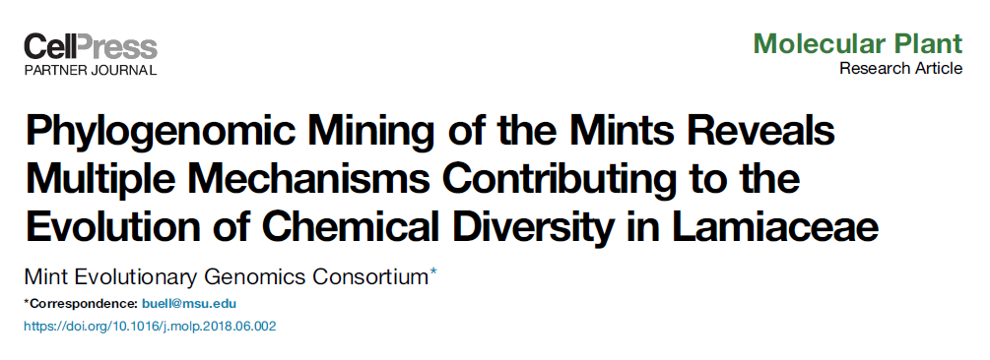
Published August 2018

Slide 2
Background
Chemical diversity is a key driver in evolutionary diversification
Specialized metabolites are made from a small group of precursors
Ex: terpenes are precursors for monoterpenes, sesquiterpenes, and iridoids
Lamiaceae is a family rich in terpenoids
For plants – anti-microbial, anti-herbivory, and pollinator attraction
For us – health, food flavoring, and agricultural purposes
Menthol – peppermint
Nepetalactone – catnip
Agnuside – progesterone normalization
Caryphyllene – food aromatic (pepper)

Slide 3
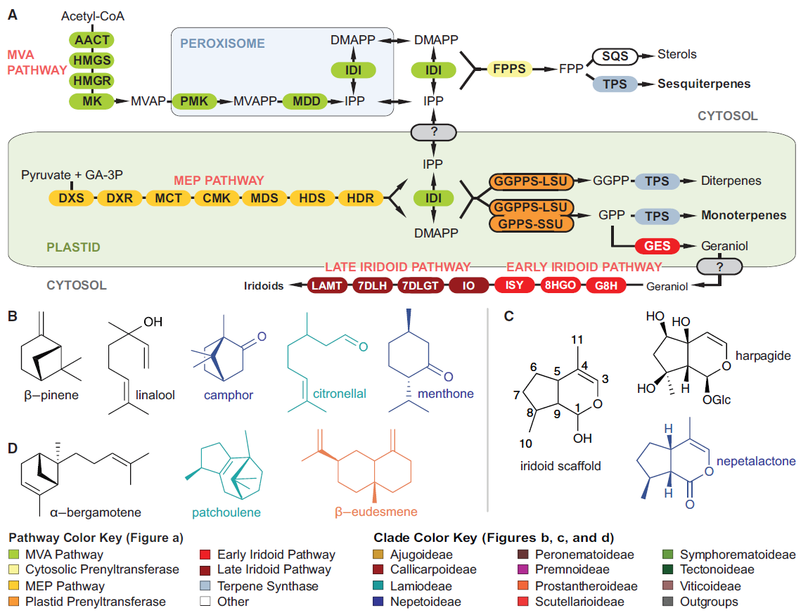
Key points:
Monoterpenes and iridoids are both derived from GPP
GPP is produced by the MEP pathway
Sesquiterpenes are produced by the MVA pathway
MVA and MEP pathways compete for IPP

Slide 4
Background
Extensive flavonoid diversity exists in Lamiaceae
GM-MS and LC-MS identified 64 iridoids, 44 monoterpenes, and 39 sesquiterpenes across all species investigated
However, evolutionary mechanisms (i.e. selective pressures) driving diversity are unknown
Goal – analyze transcriptomes and metabolomes of 48 phylogenetically diverse species of Lamiaceae to reveal evolutionary mechanics underlying chemodiversity

Slide 5
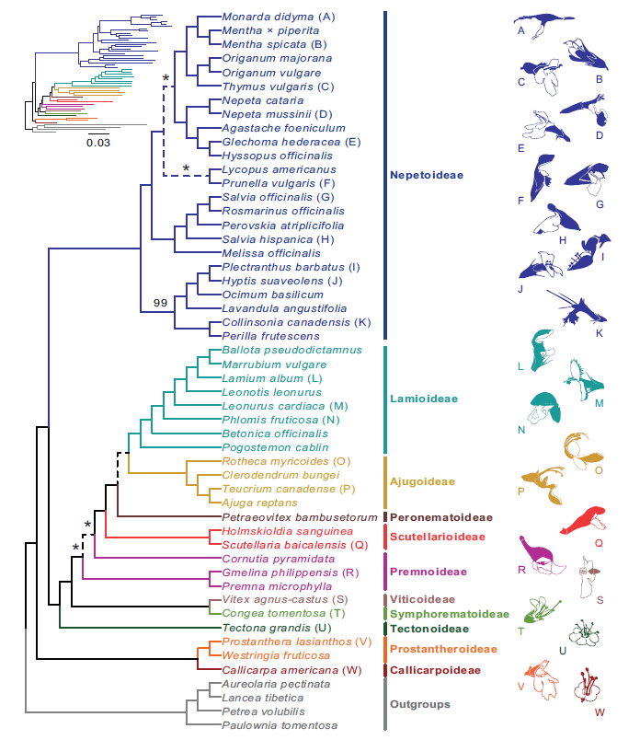
Transcriptome-based phylogeny
RNA extracted from young leaves of 48 species and 4 outgroups
Transcriptome assembled for each species
520 single-copy nuclear genes identified from angiosperm database to be present in transcriptome of all 52 species
Maximum-likelihood tree constructed based on sequences of these 520 genes

Slide 6
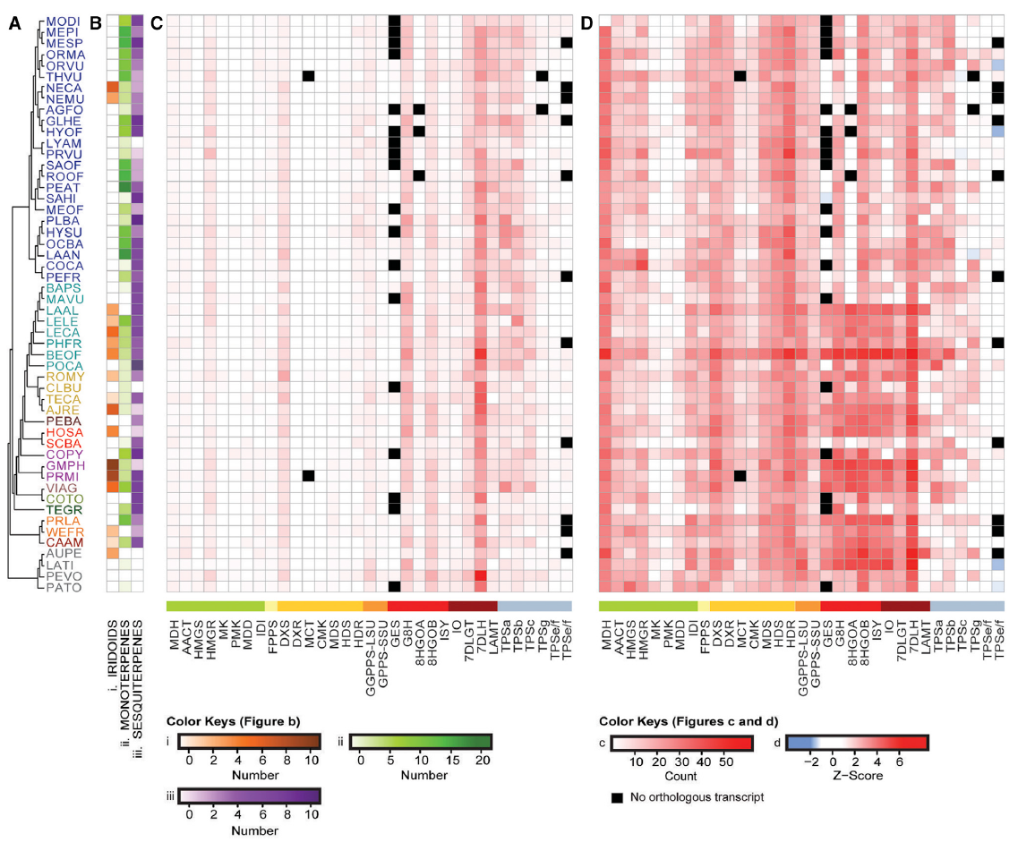

Slide 7
Metabolite profiling
Iridoid production is lost in Nepetoidaea, but restored in Nepota family
Untargeted metabolite profiling of young leaf tissue
GC-MS used to identify monoterpenes, sesquiterpenes, and 2 volatile iridoids
LC-MS used to identify iridoids
Data is “binary” – 2 possibilities for each metabolite
Detected
Not detected

Slide 8
Orthologous grouping of proteins
Previously constructed transcriptomes used to predict proteomes for each species
Proteins predicted from proteomes clustered into orthologous groups (aka orthogroup)
Orthologous – from common ancestor (i.e. a family/class of proteins with similar function)
Analysis of genes/protein groups involved in TCA cycle used to validate transcriptional representation
Detected a similar number of genes with little variation in copy number
Detected genes had similar levels of expression (Z-scores)
Conclusion – read depth is sufficient for analysis

Slide 9
Overview of phylogenomic method
Orthologous groups
Transcriptome (assembled library of mRNA)
Proteome (library of proteins generated by transcriptome)
Extracted mRNA
Trinity
BLAST2GO
Bowtie, limma
Differential gene expression data
# of genes in an orthologous group
Expression levels of orthologous groups

Slide 10
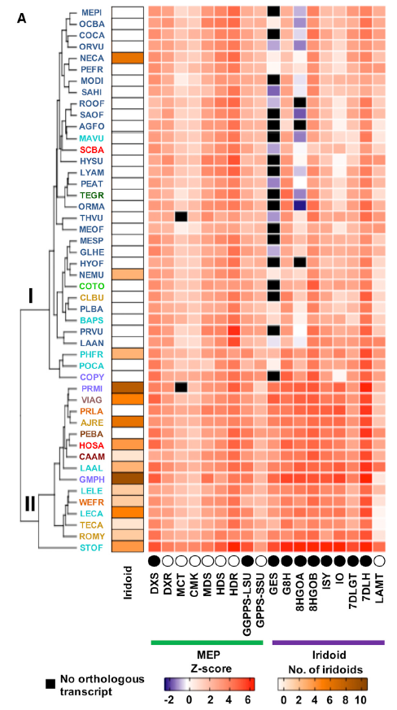
Iridoid pathway
Species clustered/ordered by iridoid pathway gene orthogroup expression levels
2 distinct clusters:
Group I – non-iridoid producing
Group II – iridoid producing
3 iridoid producing species (NECA, NEMU, PHFR) clustered in Group I
Use of genes from different orthogroups to produce iridoids
Independent evolution of iridoid pathway

Slide 11
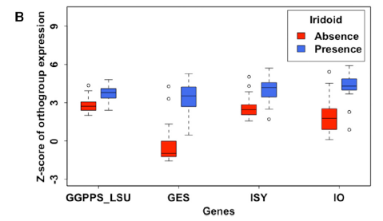
Iridoid pathway
4 orthogroups had very significant differences (P<0.001) in expression between Groups I and II
Many species in Group I (no iridoids) had no detectable GES expression – key gatekeeping step

Slide 12
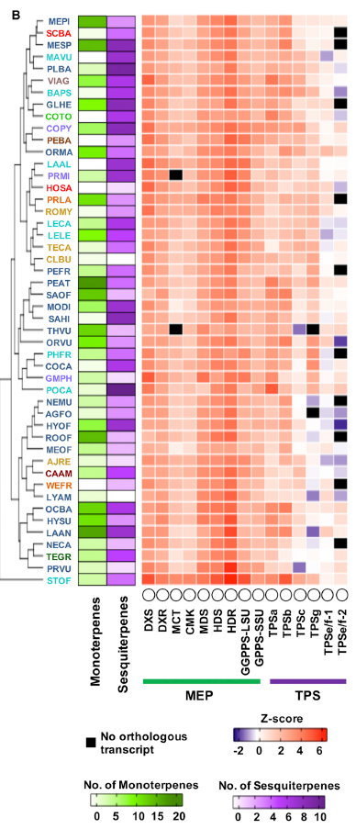
Mono- and sesquiterpene pathways
Species clustered/ordered by mono- and sesquiterpene pathway gene orthogroup expression levels
Overall weak relationship between orthogroup expression levels and mono- and sesquiterpene diversity
Primary driver is not gene expression, but rather gene family expansion (i.e. number of genes in each orthogroup)

Slide 13
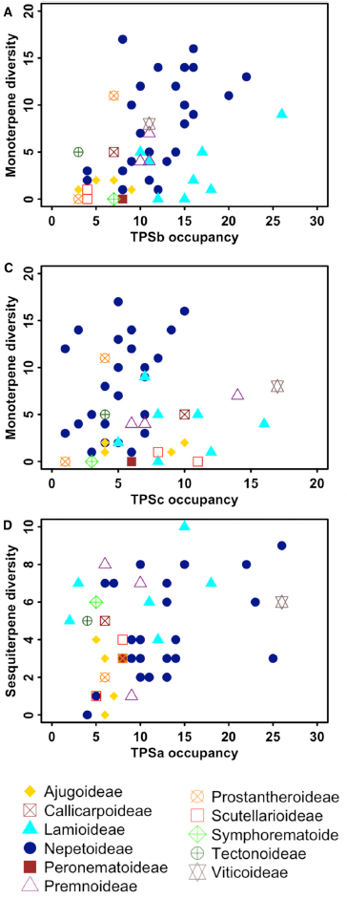
Mono- and sesquiterpene pathways
Number of genes in TPS orthogroups controls mono- and sesquiterpene diversity
TPSb and TPSc – monoterpenes
TPSa – sesquiterpenes

Slide 14
Mono- and sesquiterpene pathways
Negative relationship between GGPPS-LSU, MDS, and HDS orthogroup occupancy and sesquiterpene diversity
Positive relationship between MDD orthogroup occupancy and sesquiterpene diversity
Conclusion - Sesquiterpene precursors are provided primarily by MVA pathway, MEP

Slide 15
Discussion
In Nepetoideae, mono- and sesquiterpene volatiles serve as key defense compounds, in place of iridoid glycosides used by other species
Structural analysis shows that primary form of iridoids in family Nepeta is nepetalactone – much more volatile than traditional iridoids used by non-Nepetoideae species
Nepetalactones resemble insect pheromones – play role in plant-insect signaling

Slide 16
Discussion
In general, production of iridoids and monoterpenes is inversely correlated
GES controls flux into iridoid or monoterpene pathway
Iridoid production is associated with enhanced gene expression
Mono- and sesquiterpene production is associated with increased orthogroup size

